Slide 1
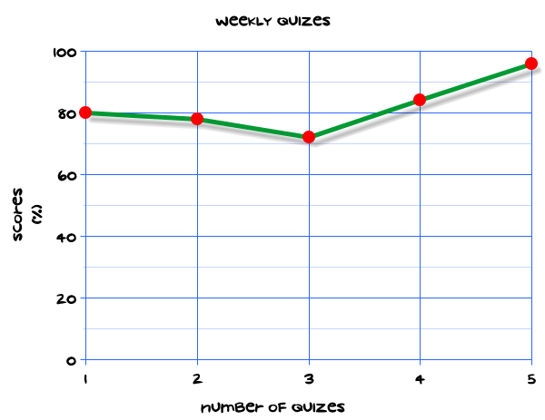
My Statistics Interactive Notebook
Name
Class
Teacher
Term 1 Semester 1
1

Slide 2
Create your own front page
It needs to contain the following –
My number interactive notebook
Name
Class
Teachers Name
Semester 1 Term 1
Page number 1

Slide 3
Contents
Glossary or Formula Page
Page
Date
Description
2
3

Slide 4
Tasks
24
7
30
Essential Question
Questions
Notes
Summary
4
5

Slide 5
24
7
30
Date
Title
EQ –
5

Slide 6
24
7
30
Date
Measures of Spread
EQ –
Explain why range and inter-quartile range are useful tools in measuring spread and how they are calculated.
5

Slide 7
24
7
30
Date
Measures of Spread
EQ –
Explain why range and inter-quartile range are useful tools in measuring spread and how they are calculated.
What is Range?
5

Slide 8
24
7
30
Date
Measures of Spread
EQ –
Explain why range and inter-quartile range are useful tools in measuring spread and how they are calculated.
What is Range?
Range is the distance between the largest and smallest values.
5

Slide 9
24
7
30
Date
Measures of Spread
EQ –
Explain why range and inter-quartile range are useful tools in measuring spread and how they are calculated.
What is Range?
Range is the distance between the largest and smallest values.
How is range calculated?
5

Slide 10
24
7
30
Date
Measures of Spread
EQ –
Explain why range and inter-quartile range are useful tools in measuring spread and how they are calculated.
What is Range?
Range is the distance between the largest and smallest values.
How is range calculated?
Range = Maximum – Minimum.
Example:
2,4,5,5,7,8,9,11,15,17,19,21
Range = 21 – 2
= 19
5

Slide 11
24
7
30
Date
Measures of Spread
EQ –
Explain why range and inter-quartile range are useful tools in measuring spread and how they are calculated.
What is Range?
Range is the distance between the largest and smallest values.
How is range calculated?
Range = Maximum – Minimum.
Example:
2,4,5,5,7,8,9,11,15,17,19,21
Range = 21 – 2
= 19
What is inter-quartile range?
5

Slide 12
24
7
30
Date
Measures of Spread
EQ –
Explain why range and inter-quartile range are useful tools in measuring spread and how they are calculated.
What is Range?
Range is the distance between the largest and smallest values.
How is range calculated?
Range = Maximum – Minimum.
Example:
2,4,5,5,7,8,9,11,15,17,19,21
Range = 21 – 2
= 19
What is inter-quartile range?
The inter-quartile range (IQR) is a measure of variability, based on dividing a data set into quartiles.
5

Slide 13
24
7
30
Date
Measures of Spread
EQ –
Explain why range and inter-quartile range are useful tools in measuring spread and how they are calculated.
What is Range?
Range is the distance between the largest and smallest values.
How is range calculated?
Range = Maximum – Minimum.
Example:
2,4,5,5,7,8,9,11,15,17,19,21
Range = 21 – 2
= 19
What is inter-quartile range?
The inter-quartile range (IQR) is a measure of variability, based on dividing a data set into quartiles.
What is a quartile?
5

Slide 14
24
7
30
Date
Measures of Spread
EQ –
Explain why range and inter-quartile range are useful tools in measuring spread and how they are calculated.
What is inter-quartile range?
The inter-quartile range (IQR) is a measure of variability, based on dividing a data set into quartiles.
What is a quartile?
Quartiles divide a rank-ordered data set into four equal parts. The values that divide each part are called the first, second, and third quartiles; and they are denoted by Q1, Q2, and Q3, respectively.
5

Slide 15
24
7
30
Date
Measures of Spread
EQ –
Explain why range and inter-quartile range are useful tools in measuring spread and how they are calculated.
What is inter-quartile range?
The inter-quartile range (IQR) is a measure of variability, based on dividing a data set into quartiles.
What is a quartile?
Quartiles divide a rank-ordered data set into four equal parts. The values that divide each part are called the first, second, and third quartiles; and they are denoted by Q1, Q2, and Q3, respectively.
How do I find the inter-quartile range of a set of data?
5

Slide 16
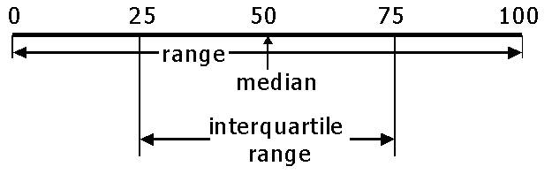
24
7
30
Date
Measures of Spread
EQ –
Explain why range and inter-quartile range are useful tools in measuring spread and how they are calculated.
What is inter-quartile range?
The inter-quartile range (IQR) is a measure of variability, based on dividing a data set into quartiles.
What is a quartile?
Quartiles divide a rank-ordered data set into four equal parts. The values that divide each part are called the first, second, and third quartiles; and they are denoted by Q1, Q2, and Q3, respectively.
How do I find the inter-quartile range of a set of data?
Find the median of the data set.
Find the median of both halves of data. The lower median is the 1st quartile. The upper median is the 3rd quartile.
Subtract the two quartile scores.
5

Slide 17
Task
Work out the median and inter-quartile range of each of the following sets of data showing clearly all the steps in your working.
Calculators allowed
3,9,12,15,16,18,21
152, 167, 159, 162, 140, 157, 163, 160, 155, 141, 158
1.4, 2.7, 0.2, 3.5, 4.1, 2.3, 1.9, 2.2, 1.6, 2.0, 1.6, 2.6, 2.2 ,1.8, 2.9, 3.0
5, 9, 11, 13, 16, 16, 19, 21
62,51,48,55,56,43,59,48,57,60,47,55

Slide 18
Task
Complete Numbers 4 & 5 on Page 41 of the text.

Slide 19
Questions

Slide 20
Notes Review
24, 7 ,30
Date
Title
Essential question
Notes complete
Notes complete with colour and diagrams
Questions completed
Contents page filed in
Formula page filled in

Slide 21
Homework
Review your notes and write a summary answering the essential question.

